Slide 1
Chapter 1 Reading 1
Marriage: A Changing Institution

Slide 2
Objectives
1. Examining graphics;
2. Reading for main ideas;
3. Reading actively;
4.Guessing meaning from context;
5.Writing about changes.

Slide 3
Part 1 Preparing to read
Words related to the topic; examining graphics
Part 2 Reading 2 (paragraph by paragraph)
1)Vocabulary Use
2)Pattern Drill
3)Discussion
Part 3 After you read

Slide 4
Preparing to Read (P4)
1. Words related to the topic:
the meaning of institution
Marriage : A Changing Institution
What does institution mean here?
a custom or tradition that has existed for a long time and is accepted as an important part of a particular society

Slide 5
Preparing to Read (P4)
Questions:
1. Decide if you think marriage is an institution.
2. What are some other examples of cultural or social institutions?

Slide 6
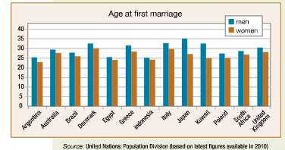
Preparing to Read (P4)
2. Examining graphics

Slide 7
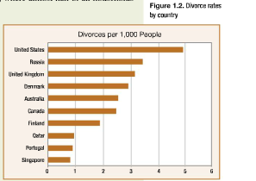
Preparing to Read (P4)
2. Examining graphics

Slide 8
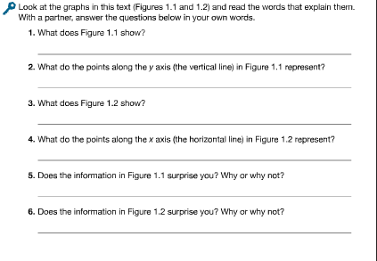
Answer the following questions

Slide 9
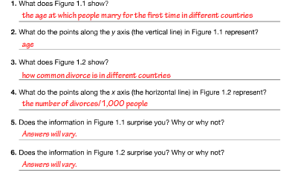
Preparing to Read (P4)

Slide 10
About marriage
https://b23.tv/av6213810
（婚姻的历史）
TED: What you don’t know about marriage

Slide 11
Reading 1 Marriage: A Changing Institution
institution[ˌɪnstɪˈtju:ʃn]
n. long-established custom, practice or group
由来已久的风俗、习惯
Example
Marriage is a sacred institution.
婚姻制度是神圣的。

Slide 12
Para 1 New Words (line 3)
ever after
从此以后一直
The fruit is good, but they loathe it ever after.
果子很好，但他们以后会永远厌恶它。

Slide 13
Para 1 Sentences
Although some people get married for love, people marry for other reasons as well.
尽管有人是因为爱情而结婚，也有人因为其他原因而结婚。

Slide 14
Para 1 Discussion
Although some people get married for love, people marry for other reasons as well.
What reasons?
economic reasons or political reasons?

Slide 15
Para 2 New Words
union [ˈju:niən]
n. (act or instance of) uniting or being united
结合，联合，合并
Example
They support the union between our two parties.
他们赞成我们两党的联合

Slide 16
Para 2 New Words
arranged marriage
a type of marital union where the bride and groom are selected by their families
包办婚姻
Example
Jeya feels that her ambitious nature made her unsuitable for an arranged marriage.
耶娅觉得她不安分的个性不适合包办婚姻。

Slide 17
Para 2 Discussion
In most, but not all, cases, the young people also participate in the decision.
What happens in other cases?

Slide 18
Para 3 New Words
variation[ˌveriˈeɪʃn]
n. a change, especially in the amount or level of sth.
（数量、水平等的）变化，变更，变异
Example
The regulation allows of no variation.
这规矩变不得。

Slide 19
Para 3 Sentences
In the United States, the median age at which people marry for the first time has risen from 22.8 for men and 20.3 for women in 1960 to 28.2 for men and 26.1 for women in 2010.

Slide 20
Para 4 Staying single New Words
indicate[ˈɪndɪkeɪt]
v. to show that sth. is true or exists
表明，显示
Example
Research indicates that eating habits are changing fast.
研究显示，饮食习惯正迅速改变。

Slide 21
Para 4 Staying single New Words
majority[məˈdʒɔ:rəti]
n. the largest part of a group of people or things
大部分，大多数
Example
The majority was/were in favour of banning smoking.
大多数人支持禁烟。

Slide 22
Para 4 Staying single New Words
postpone[pəˈspəʊn]
v. to arrange for an event, etc. to take place at a later time or date
延迟，延期
Example
The game has already been postponed three times.
这场比赛已经三度延期了。

Slide 23
Para 4
The data indicate…
One reason…
Others say that…
In short,

Slide 24
Para 5 Staying single New Words
sociological[ˌsəʊsɪəˈlɒdʒɪkl]
adj. of or relating to or determined by sociology
与社会学相关的
Example
Psychological and sociological studies were emphasizing the importance of the family.
心理学和社会学研究都在强调家庭的重要性。

Slide 25
Para 5 Staying single New Words
decline[dɪˈklaɪn]
v. to become smaller, fewer, weaker, etc.
减少，下降；衰弱，衰退
Example
Her health was declining rapidly.
她的健康状况迅速恶化。

Slide 26
Para 5 Staying single New Words
ashamed[əˈʃeɪmd]
adj. feeling shame or embarrassment about sb./sth. or because of sth. you have done
惭愧，羞愧，尴尬
Example
She was deeply ashamed of her behaviour at the party.
她对自己在聚会上的行为深感羞愧。

Slide 27
Para 5 Staying single New Words
economic security
the condition of having stable income or other resources to support a standard of living now and in the foreseeable future
经济保障
Example
Traditional ways of life provided economic security and spiritual fulfilment.
传统的生活方式提供了经济保障，满足了精神需求。

Slide 28
Para 5 Staying single Sentences
As educational and employment opportunities for women have increased, marriage is no longer the only path to economic security, emotional support, and social respectability.

Slide 29
Para 5 Staying single Discussion
There are also two important sociological reasons for this increase in the number of young people.
What are they?
Did the author number them?

Slide 30
Para 6 Staying single New Words
spouse [spaʊs]
n. a husband or wife
配偶
Example
What is the best way to keep your spouse happy in the marriage?
婚姻中让配偶幸福的最好方法是什么？

Slide 31
Para 6 Staying single New Words
significantly[sɪgˈnɪfɪkəntli]
adv. in a way that is large or important enough to have an effect on sth. or to be noticed
显著地，明显地；有重大意义地
Example
The two sets of figures are not significantly different.
这两组数字没有明显差别。

Slide 32
Para 6 Staying single New Words
still[stɪl]
adv. used for making a comparison stronger
（用于加强比较级）还要，更
Example
The next day was warmer still.
第二天更暖和了。

Slide 33
Para 6 Staying single Sentences
This includes people who have never married as well as people who are no longer married because they are divorced or their spouses have died.
单身人群包括从来没有结过婚的人，也括由于离婚或是配偶去世而不再结婚的人。
He called on you as well as me.

Slide 34
Para 6 Staying single Discussion
It is not only young people who are single, however.
What else?
Who else?

Slide 35
Para 7 The divorce rate New Words
considerable [kənˈsɪdərəbl]
adj. (formal) great in amount, size, importance, etc.
相当多（或大、重要等）的
Example
The project wasted a considerable amount of time and money.
那项工程耗费了相当多的时间和资金。

Slide 36
Para 7 The divorce rate New Words
eventually[ɪˈventʃuəli]
adv. at the end of a period of time or a series of events
最后，终于
Example
Our flight eventually left five hours late.
我们的班机最终晚了五个小时起飞。

Slide 37
Para 7 The divorce rate New Words
relatively[ˈrelətɪvli]
adv. to a fairly large degree, especially in comparison to sth. else
相当程度上；相对地
Example
I found the test relatively easy.
我觉得这次测试比较容易。

Slide 38
Para 7 The divorce rate Sentences
Even in countries such as India, where the divorce rate has traditionally been low, the rate doubled between 2005 and 2010.

Slide 39
Para 8 The divorce rate New Words
widespread[ˈwaɪdspred]
adj. existing or happening over a large area or among many people
分布广的；普遍的，广泛的
Example
The plan received widespread support throughout the country.
这项计划得到了全国的普遍支持。

Slide 40
Para 8 The divorce rate New Words
expert[ˈekspɜ:t]
n. a person with special knowledge, skill or training
专家，行家，能手
Example
She is an expert in child psychology.
她是儿童心理学方面的专家。

Slide 41
Para 8 The divorce rate Discussion
Experts give several reasons.
What are they?

Slide 42
Para 9 The divorce rate New Words
primary[ˈpraɪməri]
adj. main; most important; basic
主要的；最重要的；基本的
Example
Our primary concern must be the children.
我们首先要关心的必须是儿童。

Slide 43
Para 9 The divorce rate Discussion
Finally, the law in many countries have changed to make it easier to get divorced.
What were the first one, two?

Slide 44
Customized Speed- Dating
Customize [ˈkʌstəmaɪz]
v. to make or change sth. to suit the needs of the owner
订制，订做，改制（以满足顾主的需要）
Example
You can customize the software in several ways.
你可用几种方法按需编制这个软件。

Slide 45
Customized Speed- Dating
community[kəˈmju:nəti]
n. all the people who live in a particular area, country, etc. when talked about as a group
社区；社会
Example
The local community was shocked by the murders.
当地社会对这些谋杀案感到震惊。

Slide 46
Customized Speed- Dating
immigrate[ˈɪmɪgreɪt]
v. to come and live permanently in a country after leaving your own country
（从外地）移居，移民
Example
He decided to immigrate to Australia to find work.
他决定移居到澳大利亚找个工作。

Slide 47
Customized Speed- Dating
minority[maɪˈnɒrəti]
n. a small group within a community or country that is different because of race, religion, language, etc.
少数派，少数民族，少数群体
Example
A final settlement must respect minority rights.
最终的解决方案必须尊重少数群体的权利

Slide 48
Customized Speed- Dating
adapt[əˈdæpt]
v. to change sth. in order to make it suitable for a new use or situation
使适应，使适合（新用途、新情况）
Example
These styles can be adapted to suit individual tastes.
这些式样可以修改，以适应个性化的偏好。

Slide 49
Customized Speed- Dating
Discussion:
1.What is customized speed-dating?
2. Do we have such speed-dating in China?
3. How do you find your boy friend or girl friend?

Slide 50
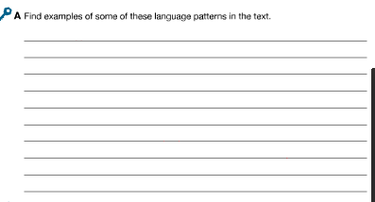
After you read: Writing about changesP.11-12

Slide 51
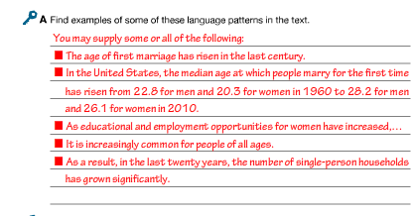
After you read: Writing about changesP.11-12

Slide 52
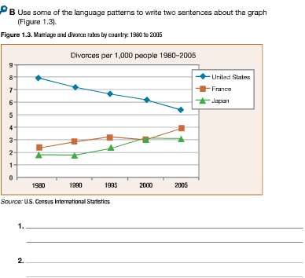
After you read: Writing about changesP.11-12

Slide 53
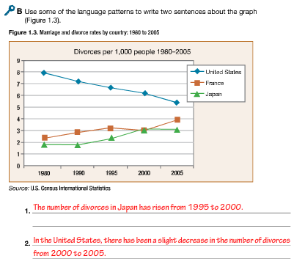
After you read: Writing about changesP.11-12

